Slide 1
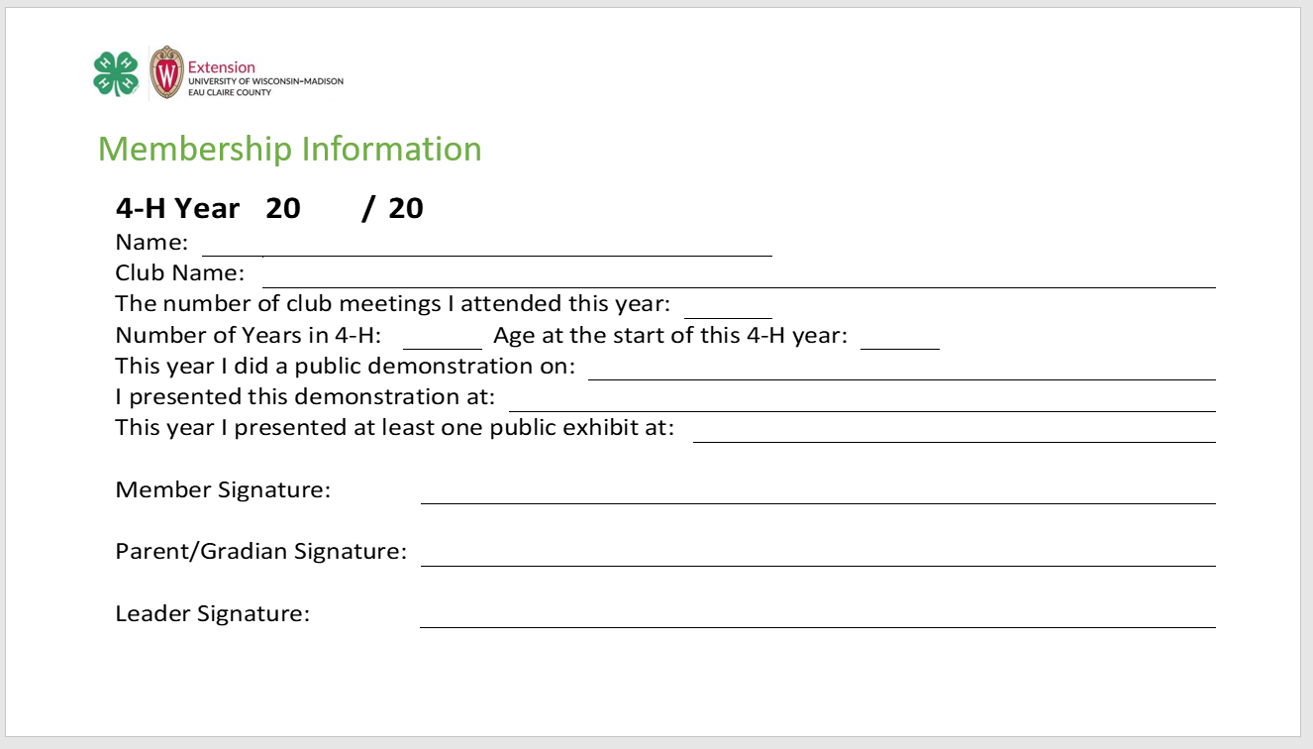

Record Book Instructions
This format is for 3rd through 12th grade using Mircosoft PowerPoint
One of the requirements to achieve in Eau Claire County 4-H is to create and submit a record book each year. The actual due date varies from club to club, so please check with your club’s general leader. Besides achieving, doing a record book has many benefits.
It is necessary to be nominated for county awards.
It is necessary when applying for 4-H Experience(s)s (trips).
It teaches life skills of good record keeping.
Encourages reflection on the year which enhances project learning.
PLEASE READ ALL INSTRUCTIONS BEFORE COMPLETING
DO NOT INCLUDE THESE INSTRUCTION slideS WITH YOUR FINISHED RECORD BOOK | Membership Information This slide is to document information about you and to capture signatures. An achieving 4-H member: Attended at least four club meetings Presented a public demonstration Presented a public exhibit Submitted a completed record book Fill in the year section with the corresponding 4-H years. Click your cursor at the beginning of each underline and begin typing. Print this slide and submit with the required signatures with the item/link you have saved your PowerPoint on.
On this slide, insert either a picture or a video of yourself.

Slide 2
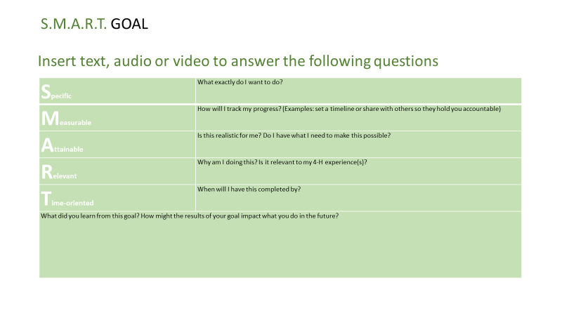
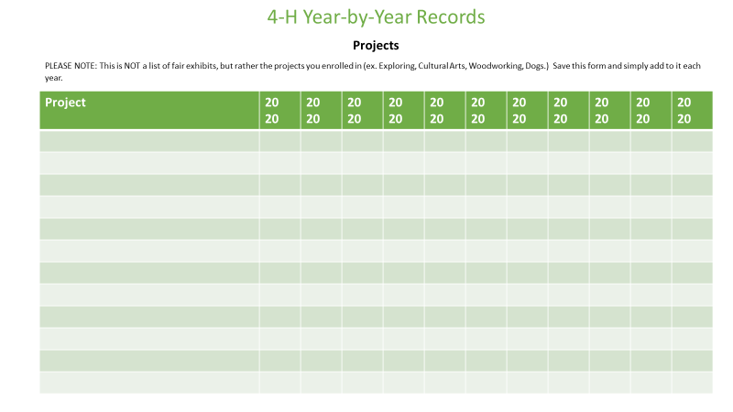
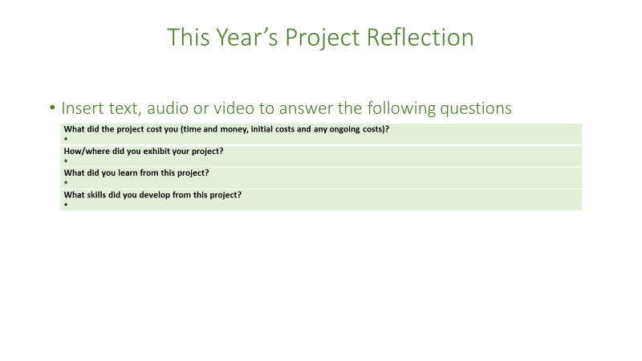
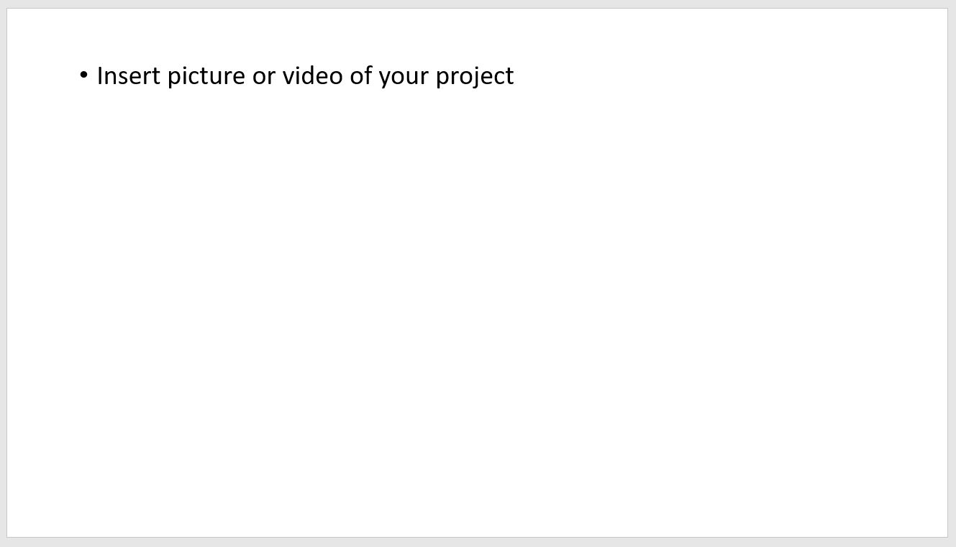
SMART Goals
Please set and document at least one Smart Goal. To document additional Smart Goals, please duplicate this slide.
Smart Goal(s) should be set at the beginning of each 4-H year.
Your Smart Goal(s) should be specific to a 4-H project and/or 4-H related.
Once you have achieved your Smart Goal(s), complete the “What did you learn” portion of this slide. (If you do not achieve your Smart Goal(s), document why)
4-H Year by Year Records – Projects
Use this slide to list all of the projects you have enrolled in on 4-Honline.
This is NOT a list of fair/public exhibits, but rather the projects you
enrolled in (ex. Exploring, Cultural Arts, Woodworking, Dogs.)
Double Click in each cell below “Name of Project” and begin typing. Fill in the years and check off each corresponding project.
Save this slide and simply add to it each year.
This Year’s Project Reflection
Please select and reflect on at least one project from this year. To reflect on additional projects, please make a copy of this slide.
You will need to answer each question. (keeping receipts will be helpful to complete this slide)
Please be certain to include a picture of each project you selected to reflect on if you are entering text or audio. If inserting a video, make sure your finished project is in the video.
DO NOT INCLUDE THESE INSTRUCTIONAL SLIDES WITH YOUR FINISHED RECORD BOOK

Slide 3
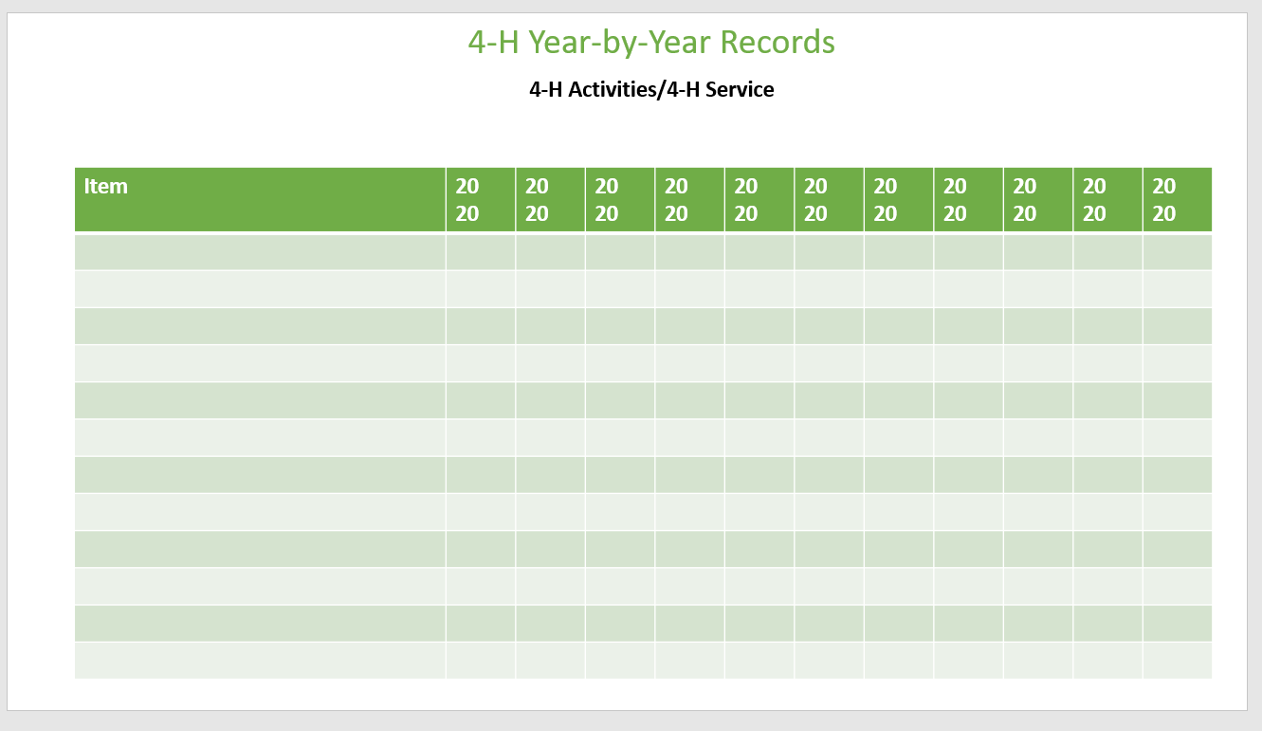
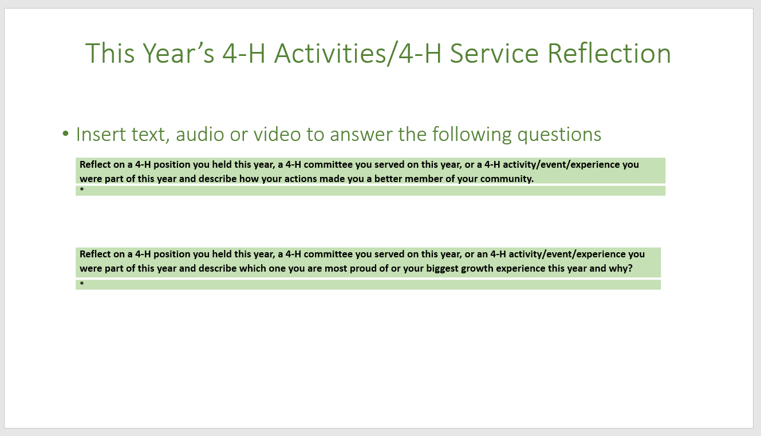
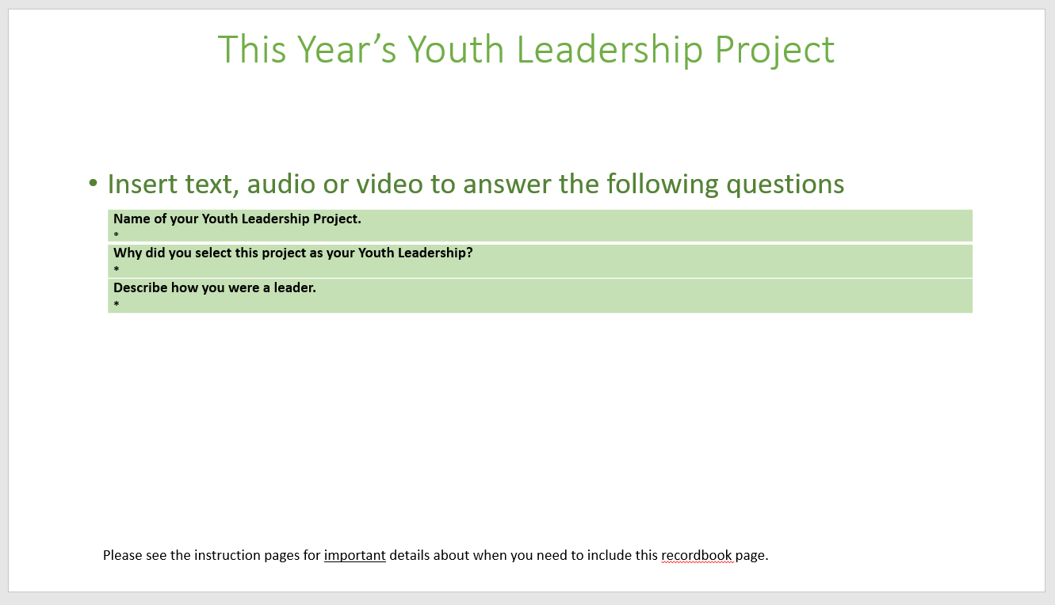
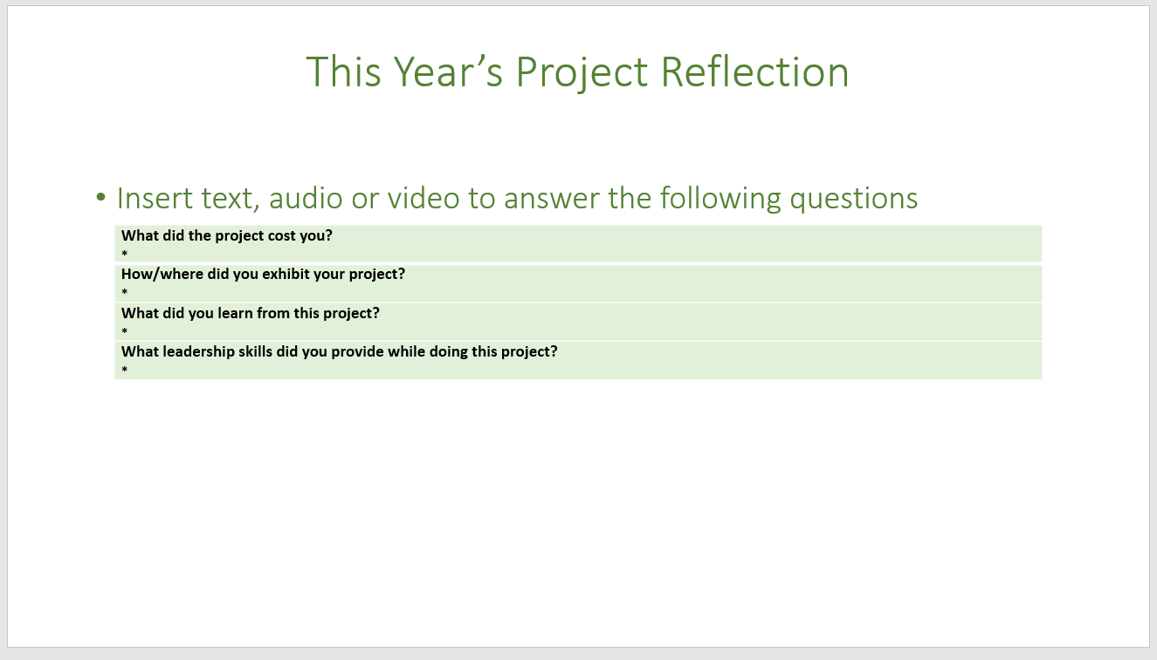

4-H Year by Year Records – Activities/Service
Use this slide to list items you participated in at your club, county, state and national level:
4-H activities
4-H events
4-H community service
4-H experiences (trips)
4-H officer positions you have held
4-H committees you have served on
Double click in each cell below “Item” and begin typing. Fill in the years and check off each corresponding item.
Save this slide and simply add to it each year
This Year’s 4-H Activities/4-H Service Reflection
Please select and reflect on at least one of the following.
  4-H position you held this year
  4-H committee you served on this year
  4-H activity/event/Experience(s) you were part of this year
You will need to answer each question. To reflect on more than one, please make a copy of this slide.
This Year’s Youth Leadership Project
IF YOU PLAN ON REQUESTING FUNDS FOR AN EDUCATIONAL EXPERIENCE(S) (4-H TRIP) OR YOU WOULD LIKE A CHANCE TO BE NOMINATED BY A LEADER FOR A COUNTY AWARD, YOU ARE REQUIRED TO ENROLL IN THE YOUTH LEADERSHIP PROJECT AND THIS RECORD BOOK slide IS REQUIRED. If neither of these interest you, this record book slide can be omitted.
Please be certain to include a picture of your YL project in action if you are entering text or audio. If inserting a video, make certain the video includes your YL Project in action.
DO NOT INCLUDE THESE INSTRUCTIONAL SLIDES WITH YOUR FINISHED RECORD BOOK

Slide 4
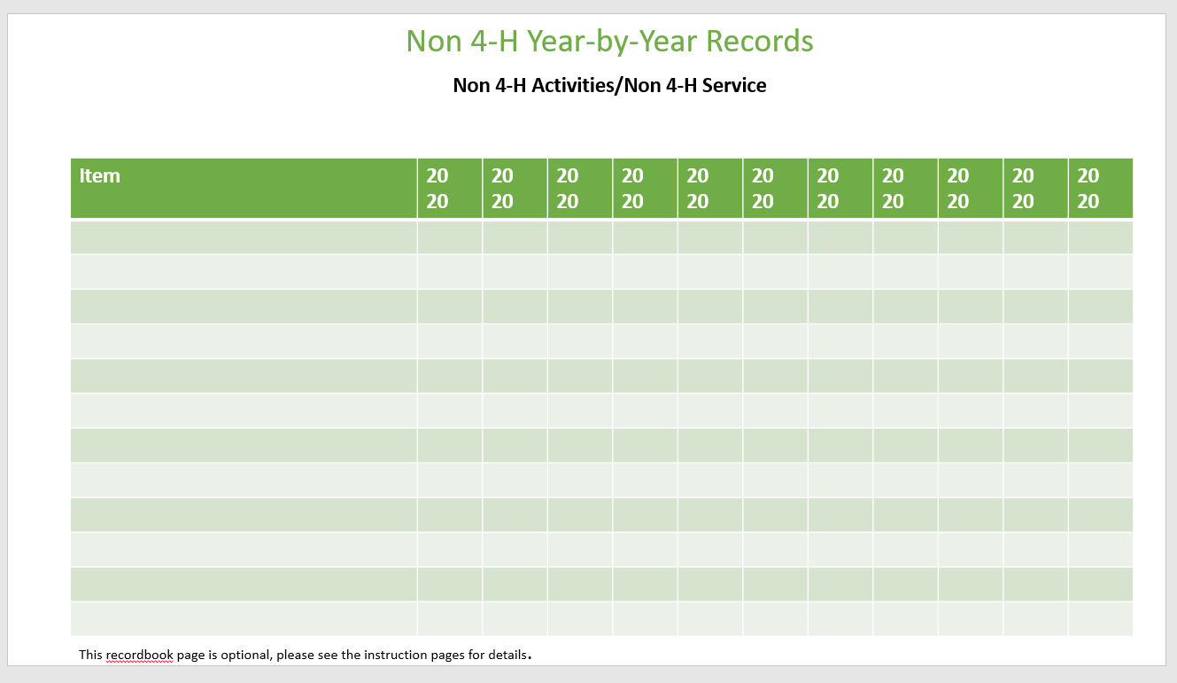
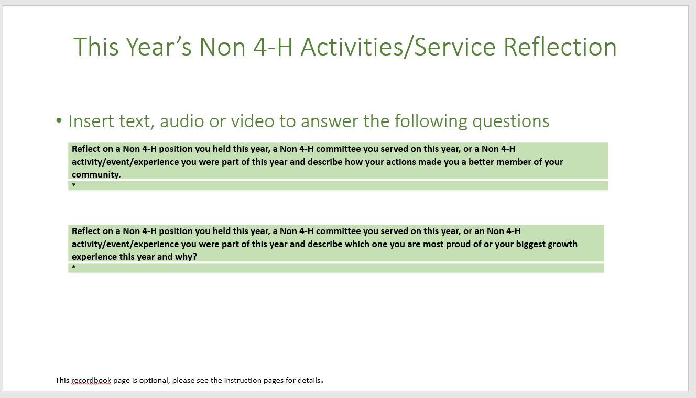
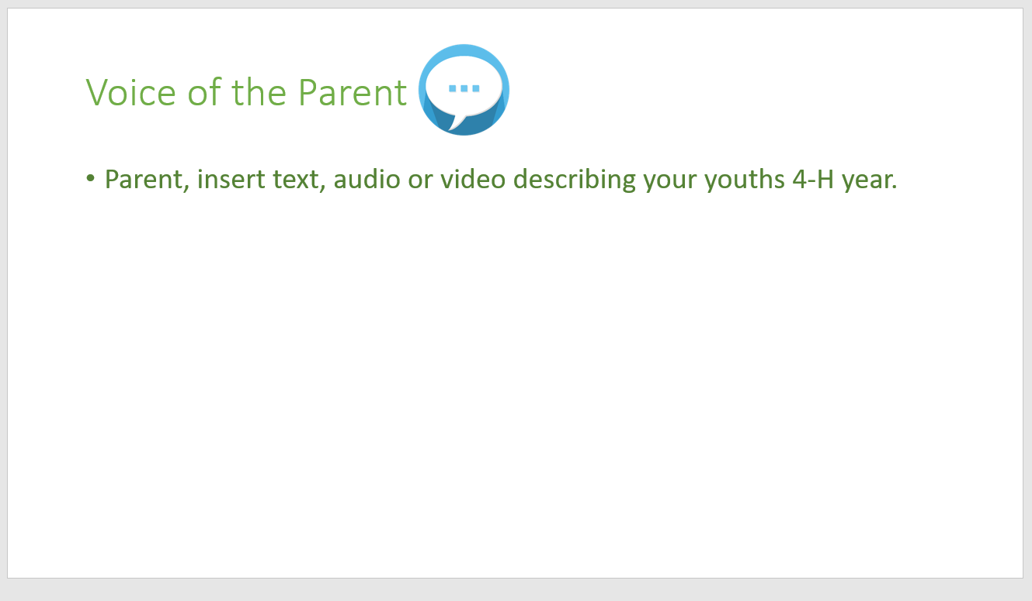
Non 4-H Year by Year Records -Non 4-H Activities/Non 4-H Service
THIS RECORD BOOK slide IS OPTIONAL and can be omitted. Use this slide to list Non 4-H items you participated in:
Non 4-H activities
Non 4-H events
Non 4-H community service
Non 4-H educational Experience(s)s (trips)
Non 4-H officer positions you have held
Non 4-H committees you have served on
Double click in each cell below “Item” and begin typing. Fill in the years and check off each corresponding item.
Save this slide and simply add to it each year
This Year’s Non 4-H Activities/Non 4-H Service Reflection
THIS RECORD BOOK slide IS OPTIONAL and can be omitted.
Please select and reflect on at least one of the following.
  Non 4-H position you held this year
  Non 4-H committee you served on this year
  Non 4-H activity/event/Experience(s) you were part of this year
You will need to answer each question. To reflect on more than one, please make a copy of this slide.
Voice of the Parent
This slide is completed by your parent/guardian. This is their point of view of how your 4-H year went.
Parent/guardian should click in the text box and begin typing. You may also print this slide and submit with the device you have saved your PowerPoint on with parent’s/guardian’s comments. You may also insert an audio or a video with parent’s/guardian’s comments.
DO NOT INCLUDE THESE INSTRUCTIONAL SLIDES WITH YOUR FINISHED RECORD BOOK

Slide 5
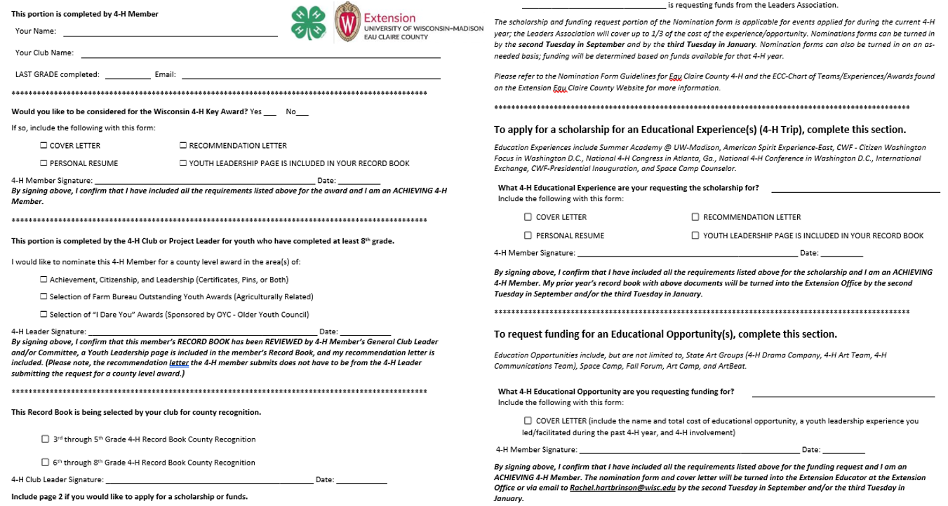
Please submit this form with the device (i.e.. Flash drive) you are saving this presentation on or provide the link to where you have saved this presentation electronically (i.e.. Google drive, Dropbox).
*If sharing electronically, make sure the link is visible to anyone with the link. More information can be found here. Share a file publicly
Please note: If you would like to include additional slides in your record book with more pictures and/or include ribbons and certificates you are welcome to do so. However, outside of where it is specifically indicated to include pictures, it is not a requirement to include more.
You can find the typeable form in the Microsoft Word version.
DO NOT INCLUDE THESE INSTRUCTIONAL SLIDES WITH YOUR FINISHED RECORD BOOK

Slide 6

Membership Information

Slide 7
Insert picture or video of yourself

Slide 8
S.M.A.R.T. GOAL
Insert text, audio or video to answer the following questions
Specific | What exactly do I want to do?
Measurable | How will I track my progress? (Examples: set a timeline or share with others so they hold you accountable)
Attainable | Is this realistic for me? Do I have what I need to make this possible?
Relevant | Why am I doing this? Is it relevant to my 4-H experience(s)?
Time-oriented | When will I have this completed by?
What did you learn from this goal? How might the results of your goal impact what you do in the future?

Slide 9
4-H Year-by-Year Records
Projects
PLEASE NOTE: This is NOT a list of fair exhibits, but rather the projects you enrolled in (ex. Exploring, Cultural Arts, Woodworking, Dogs.) Save this form and simply add to it each year.
Project | 20 20 | 20 20 | 20 20 | 20 20 | 20 20 | 20 20 | 20 20 | 20 20 | 20 20 | 20 20 | 20 20

Slide 10
This Year’s Project Reflection
Insert text, audio or video to answer the following questions
What did the project cost you (time and money, initial costs and any ongoing costs)? *
How/where did you exhibit your project? *
What did you learn from this project? *
What skills did you develop from this project? *

Slide 11
Insert picture or video of your project

Slide 12
4-H Year-by-Year Records
4-H Activities/4-H Service
PLEASE NOTE: Use this slide to list 4-H activities, 4-H events, 4-H community service, 4-H educational Experience(s)s (4-H trips), 4-H officer positions, and 4-H committees you have served on at your club, county, state and/or national level. Save this form and simply add to it each year.
Item | 20 20 | 20 20 | 20 20 | 20 20 | 20 20 | 20 20 | 20 20 | 20 20 | 20 20 | 20 20 | 20 20

Slide 13
This Year’s 4-H Activities/4-H Service Reflection
Insert text, audio or video to answer the following questions
Tell us about a 4-H position you held, a 4-H committee you served on, or a 4-H activity/event/educational Experience(s) you were part of this year. Reflect on how this impacted you, your club, or your community; why was it important to you?
*

Slide 14
This Year’s Youth Leadership Project
Insert text, audio or video to answer the following questions
Tell us about your Youth Leadership Project. (Why did you select this project? What did the process look like? How did it turn out?) *
What was challenging about this project? Would you change anything if you were to do this project again? *
How did this provide leadership opportunities for you? Share what you learned about yourself. *
Please see the instruction slides for important details about when you need to include this record book slide.

Slide 15
Insert picture or video of your Youth Leadership in action
Please see the instruction slides for important details about when you need to include this record book slide.

Slide 16
Non 4-H Year-by-Year Records
Non 4-H Activities/Non 4-H Service
This record book slide is optional, please see the instruction slides for details. PLEASE NOTE: Use this slide to list non 4-H activities, non 4-H events, non 4-H community service, non 4-H educational Experience(s)s (trips), Non 4-H officer positions, and Non 4-H committees you have served on. Save this form and simply add to it each year.
Item | 20 20 | 20 20 | 20 20 | 20 20 | 20 20 | 20 20 | 20 20 | 20 20 | 20 20 | 20 20 | 20 20
This record book slide is optional, please see the instruction slides for details.

Slide 17
This Year’s Non 4-H Activities/Service Reflection
Insert text, audio or video to answer the following questions
Tell us about a Non 4-H position you held, a Non 4-H committee you served on, or a Non 4-H activity/event/educational Experience(s) you were part of this year. Describe how your actions impacted your community or world?
*
This record book slide is optional, please see the instruction slides for details.

Slide 18

Voice of the Parent
Parent, insert text, audio or video describing your youth’s 4-H year.

Slide 19
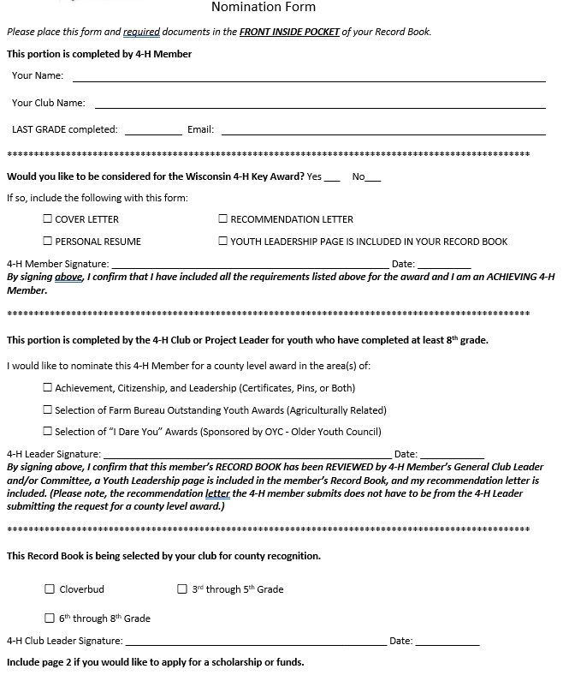
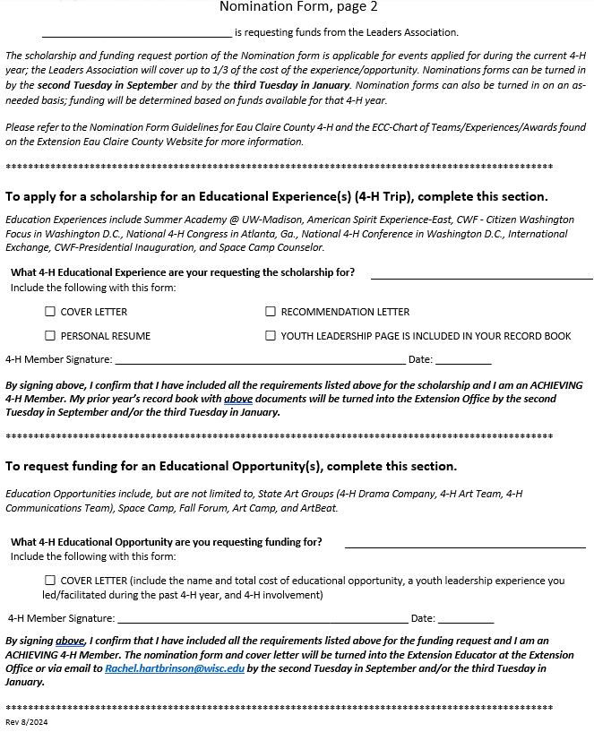

Print this slide and include with device or link you saved this presentation on.
You can find the typeable form in the Microsoft Word version.

